Slide 1
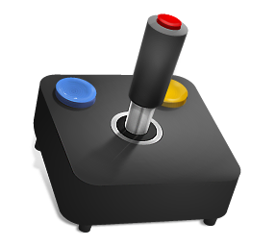
Android Games Analysis – Why Does my playtime reduce my talk time?
Team – Hunger-Games
Milind Gokhale
Renuka Deshmukh

Slide 2


Motivation
Games => 16% of the total time spent on mobile apps in US. _{COMSCORE}
Appeal to diverse group of audience
Advent of modern technology and higher configuration => innovative games
Mobile game revenues will reach $28.9Bn by 2016, up 38% from 2014.

Slide 3
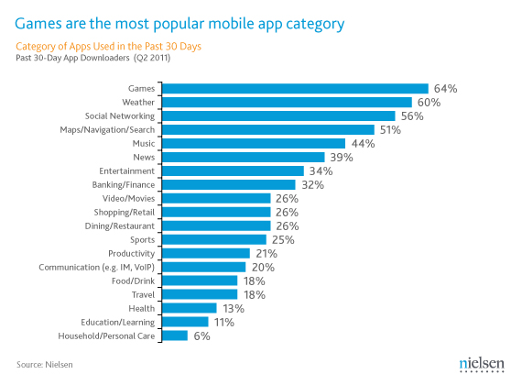
Most popular mobile app category

Slide 4



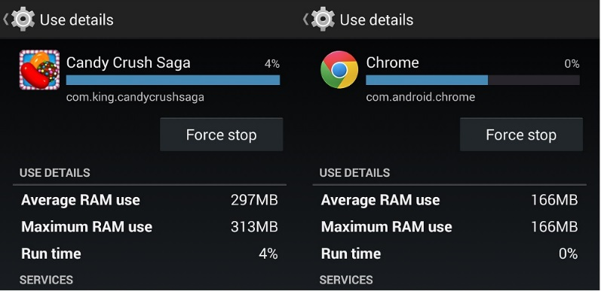

However there are problems
High Battery Usage
High Data Usage
High Memory Usage
Performance Slowdown

Slide 5
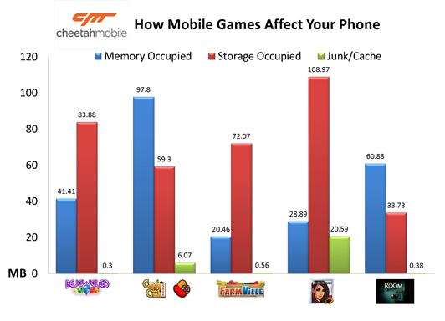
Related Work
Study by Cheetah Mobile

Slide 6
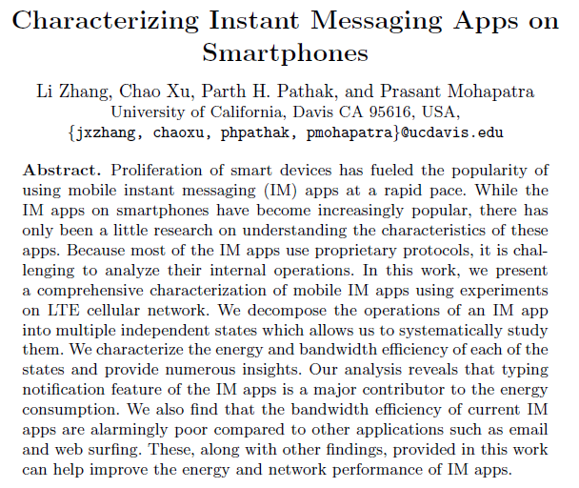

Related Work
Verizon Wireless – High Risk Apps
Characterizing Instant Messaging Apps on Smartphones
http://www.verizonwireless.com/support/high-risk-android-apps/

Slide 7
Unexplored Area: Mobile Games
Numerous genres
Numerous Games in every genre
Characterization of games difficult
Age group
Liking
Location
Different Resource requirements and limitations

Slide 8
Project Idea
What can be done?
Trying to find the root cause of inefficiencies in online mobile games in terms of memory usage, data usage and performance.
Approach
Data Collection
Analysis
Recommendation

Slide 9
Methodology
Game States
Experiment Setup
Games
Tools
Test Subjects
Test Cases
Testing Steps and Analysis Approach

Slide 10





Game States
Foreground
Background
Idle
Playing

Slide 11





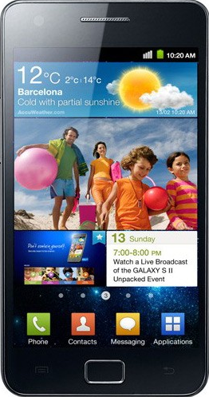

Experiment Setup
Rooted

Slide 12





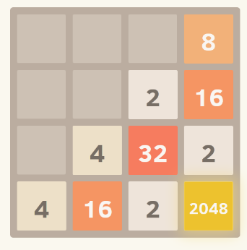
Games and Tools
Farm Heroes Saga
Social
2048
Casual
ARO
Wakelock Detector
Power Tutor
Usemon
Greenify

Slide 13
Test Design
No need of test subjects
 | Description | Network Channel
1 | Game Screen On, Idle | No Internet/Wi-Fi/LTE
2 | Game Playing | No Internet/Wi-Fi/LTE
3 | Ad Statistics | Wi-Fi/LTE
4 | App in background | Wi-Fi/LTE

Slide 14
Test Execution
Execution steps
Close all running apps using Greenify
Connect phone to laptop running ARO via USB
Start ARO data collector
Begin playing the game for 5 mins
Analyze test report
Metrics
Data transfer (bytes/sec)
Energy Consumption (J)
Energy Efficiency (J/sec)

Slide 15

Findings

Slide 16
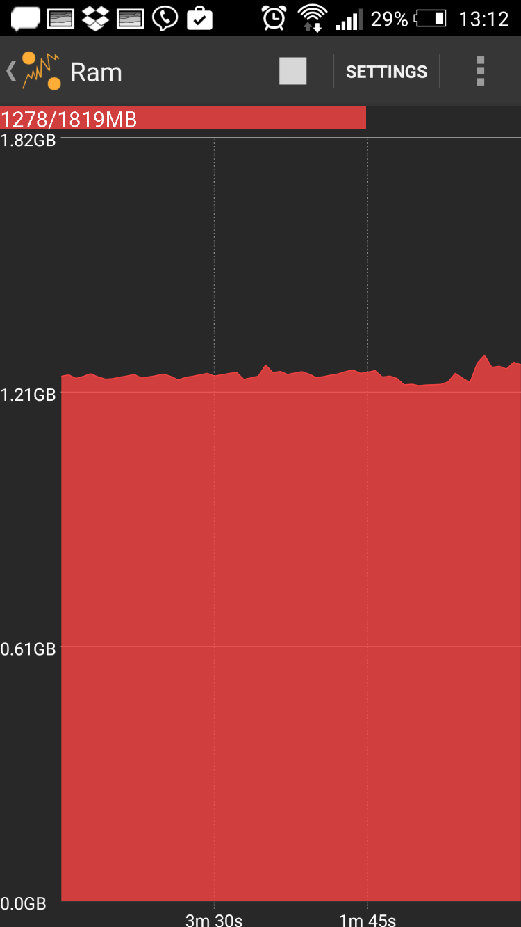
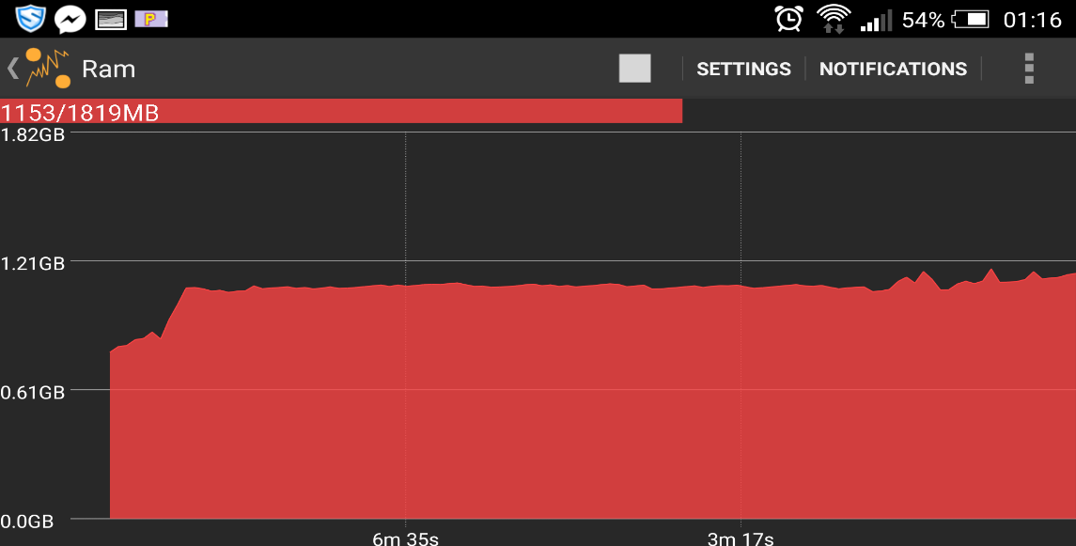
High RAM Usage
More than 1 GB of RAM used while playing 2048 and Farm Saga.

Slide 17
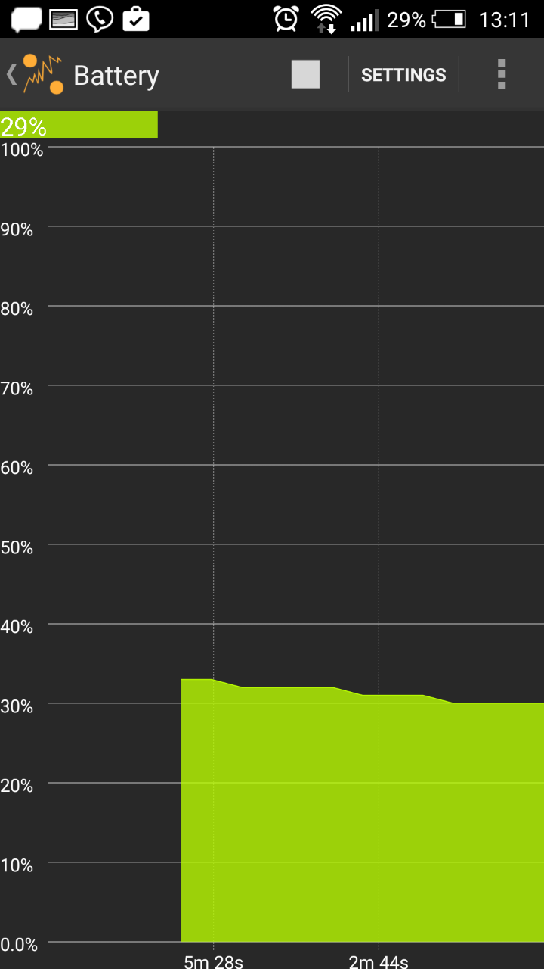
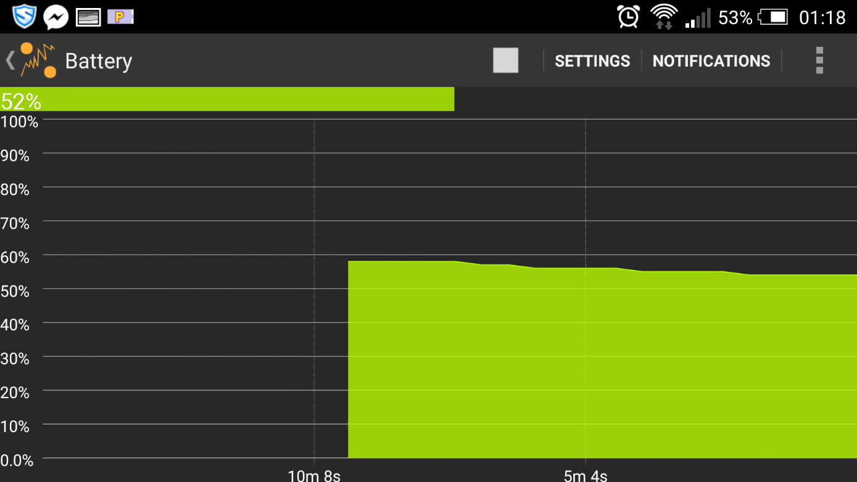
High Battery Consumption
While playing 2048 and Farm Saga
9% (59% to 52%) in about 9 mins
Hence – Full battery drain in 100 mins

Slide 18
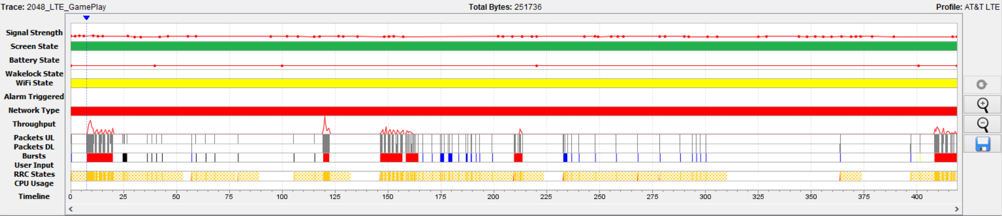
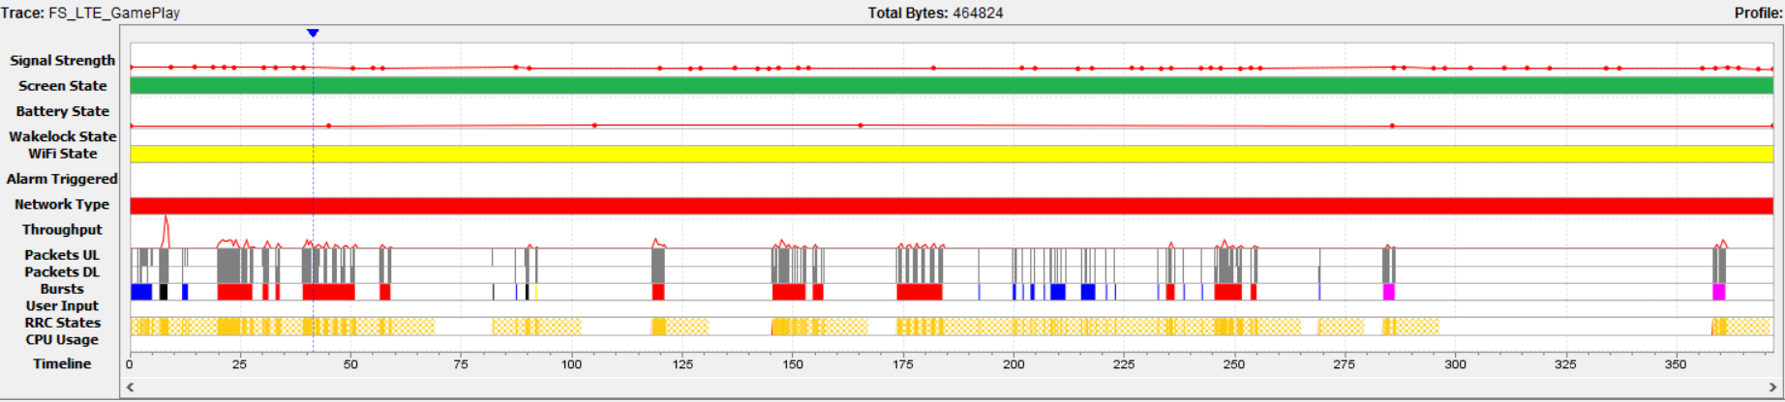
Unexpected High Data Usage
2048 & Farm Saga Using high data in LTE

Slide 19
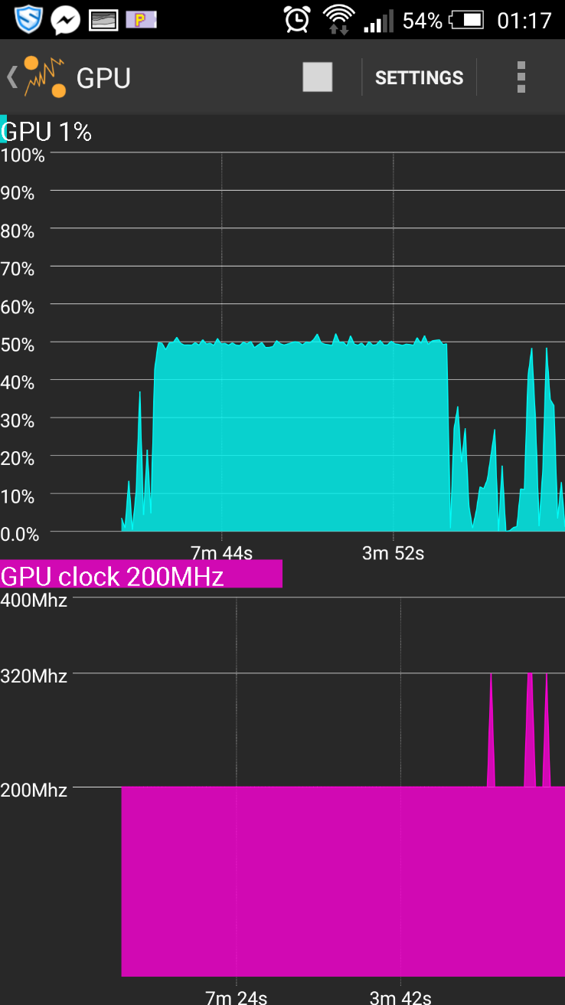
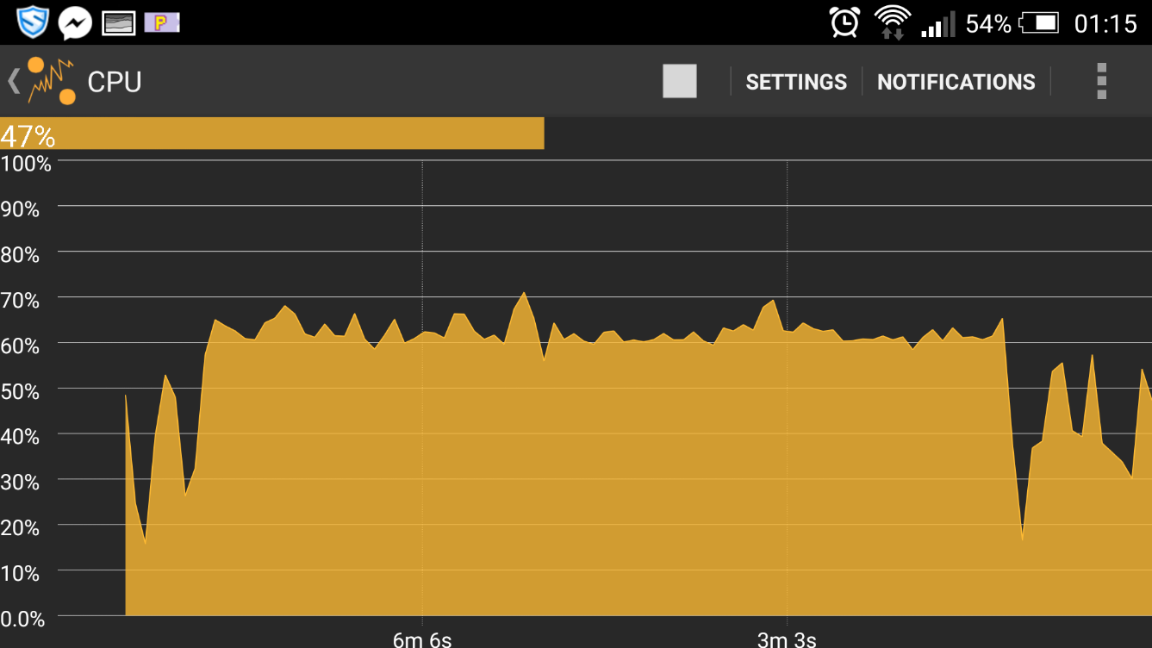
Performance Slowdown
High CPU Usage
High GPU Usage

Slide 20
Findings: Foreground - Idle
Screen ON
Farm Saga - Overrides default screen timeout
2% (210 J) battery drain in 5 mins
RRC States
Too many UDP connection requests for NoInternet
Unnecessary RRC state transition
NoInternet - DCH 38.91% , FACH 43.66%
Connection Bursts Grouping
Multiple bursts for 2048 and Farm Saga
Connection grouping can save power

Slide 21
Findings: Foreground - Playing
Connection Closing – Energy wastage in connection control
Farm Saga – Avg. 25% energy (16.9 J – 84.5 J) wasted
2048 – Avg. 50% enery (37.9 J – 161 J) wasted
Duplicate TCP Content
Farm Saga – 29% duplicate data
50% cache header absent

Slide 22
Findings: Background
2048 – No requests to game or ad server
Farm Saga
17 requests to game server
6 requests to FB server in 5 mins

Slide 23

Ad Stats
Uncompressed Files
Javascript, HTML, CSS and text files should be minified
CSS Rule “display:none;”
Content not displayed on page should be removed from HTML
Probable Ad Fraud
Heuristic to detect the game session end
Domains Accessed (2048 Gameplay)
Row Labels | Requests per domain | Sum of Byte Count | Sum of Packet Count
ads.get.it | 3 | 131530 | 264
ads.mopub.com | 6 | 5899 | 32
android.clients.google.com | 2 | 8088 | 31
cpp-test.imp.mpx.mopub.com | 3 | 3773 | 22
get.it | 6 | 5607 | 51
in.metamx.com | 3 | 3697 | 21
play.googleapis.com | 3 | 384 | 6
rtb-05.get.it | 5 | 4966 | 41
Grand Total | 31 | 163944 | 468

Slide 24
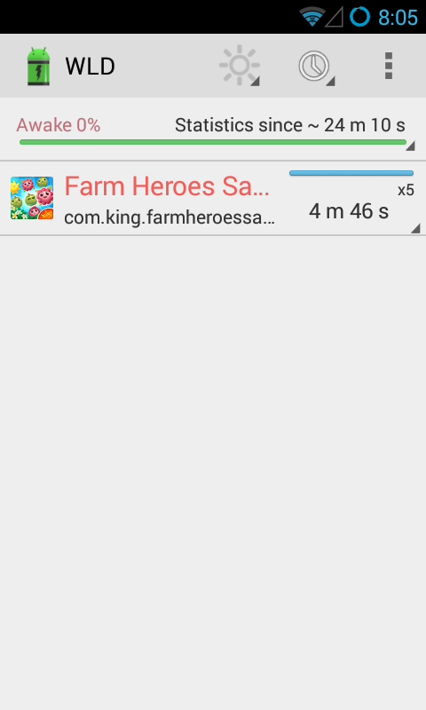
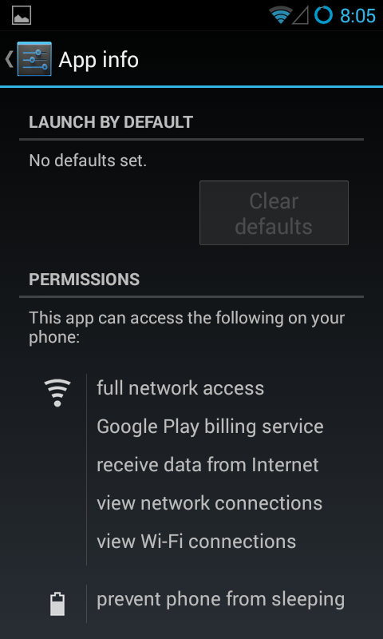
Wakelocks
Wakelocks should not be misused.
If there is no user interaction turn off screen
User Privacy
HTTPS Connections

Slide 25
Challenges Faced
ARO test error
No impact
PCAP file analysis giving error
Wireshark
ADB and drivers issue
Phone restart
No issue on rooted phone
Game data isolation
IP addresses from trace
Unavailability of a good sensor tool
Usemon

Slide 26

Future Work
Game Code Analysis
Other types of games
Code Offloading
iOS Devices
Recommendation Implementation
Study Other Resources

Slide 27

Recommendations
Multiple connection bursts should be grouped together
TCP connections should be closed promptly after data transfer
Cache Control should be implemented properly
No requests to game server or ad server when in background
Minification of files
“display:none;” - Remove not displayed content from page
No requests to ad server when the game in progress
Wakelock should not be misused

Slide 28


Conclusion
Industry perspective
Better games and efficient resource consumption
Increase in games usage and revenues
End-user perspective
Controlled data usage
Better performance
Better battery life

Slide 29
Timeline
Feb 13, 2015 – Mar 8, 2015: Design
Identifying test subjects.
Initial Design, Tools and installations.
Games finalization
Hardware acquisition (SIM and phones if required)
Mar 9, 2015 – Apr 16, 2015: Implementation
Data Collection Phase
Data Analysis
Recommendation
Apr 17, 2015 – Apr 30, 2015: Project Report

Slide 30

Thank you
Questions

